Slide 1

ABC TELECOM
Complaint Redressal System

Slide 2
TEAM MEMBERS :
1. Damodhar Reddy
2. Vinita Zugare
3. Gayathri vellaturi
4. Gopi Vatte
5.Vaddi Bhargav
6. Syed Akther
7. T. Midhun Kumar
8. Varsha Shewale
9. Vaishnavi Gheware
10. Spandana H D
11.Sunkari Karunakar Reddy
FRONTEND
BACKEND
TESTING

Slide 3
CONTENTS
Abstract
Application proposed
Modules for Complaint-Redressal-System
Tools & Languages Used
System Requirements
Features Available
Admin Flow & User Flow
ER diagram
Advantages & Scope Improvements
Screenshots

Slide 4
ABSTRACT
The main Objective of our application is to store the data of COMPLAINT raised by our customer using our services, where we can add ,delete and update the status of the complaint using– CRUD operations .
In this Generation , management tool is very much needed to manage things in single application, which is more comfortable rather than using multiple application or else directly interacting with database.
In this we also add the feature of login purpose where only authorized users can only use our application .

Slide 5
APPLICATION PROPOSED
The proposed system is specially for the customers who are facing issues while using telecom services.
In this system, the customer has to file the complaint and a ticket with unique ID will be generated and given to them.
This complaint will be assigned by the manager to the respective engineer with the respective PINCODES.
The customer can view the ticket status using their ticket IDs and one customer can also raise more than 1 ticket at a time.

Slide 6
Modules for Complaint Redressal System:
Admin
Customer
Home
Manager
Engineer
Feedback
About Us
Contact Us

Slide 7




TECHNOLOGIES USED
•Front-End: Angular
•Server-side: Spring Boot.
•Back-end: MYSQL, Hibernate.
•Server: Tomcat

Slide 8
ADMIN
CUSTOMER-
Enables the customers to login to the portal to raise and track complaints related to the services availed by them.
MANAGER-
Enables the manager to login, view the complaints raised by the customers and assign the ticket to the engineers based on the PIN Code.
ENGINEER-
Enables the engineers to pick up the tickets, work on them, enter the status of the task. They can also re-assign it to the Field Workers if they cannot resolve it from the data center.

Slide 9
CUSTOMER
Customer will be able to do :
1. Raise or create a complaint
2. view complaints
3. tracking the complaint
4. providing feedback on the resolution of the complaint through the web UI.
5. The feedback provision is an optional feature.
6. Customers should provide the following minimal details such as name, address (with PIN Code), telephone / mobile number, type of problem (cannot make a call, but receive a call or can make calls, but cannot receive calls, or neither make nor receive calls).
7. Once successfully submit the complaint, a ticket is raised and shared it with the customer.
8. At that time, the status of the ticket will be ‘RAISED’

Slide 10
MANAGER
Manager will be able to do :
pick the tickets from the active ticket list and assign them to the engineers based on the PIN code of the customer (where the service is installed).
There should be different managers to take care of different PIN codes.
You are expected to use at least about 5 –10 different PIN codes, and there should be as many managers as possible for assignment.
see the status of all the tickets in all the areas.

Slide 11
ENGINEER
engineer will be able to do :
Log in and view all the tickets assigned to him/her
pick the tickets assigned to them and assign it the status of ‘WIP”, (work on the case, which is dependent on the type of problem and resolve) and update the status as ‘RESOLVED’.
In case they are not able to resolve the issue at their end, they can remark that this needs to be reassigned to Field Workers in case of a cable fault or at the customers’ site, and flag it as ‘ESCALATED”.
All the activities of all the use cases should be appropriately bound by session or other alternatives. Appropriate time-out to be provided for each user.

Slide 12
Features Available :
Customer
Register
Login
Complaint
Send Feedback
Logout
Admin
Login
View Manager
View Engineer
View Customer
View Complaints
Update And Delete

Slide 13
Features Available :
Manager
Register
Login
View Complaints
Assign Engineer
Logout
Engineer
Register
Login
View Complaint
Resolve issue
Update status
Logout

Slide 14
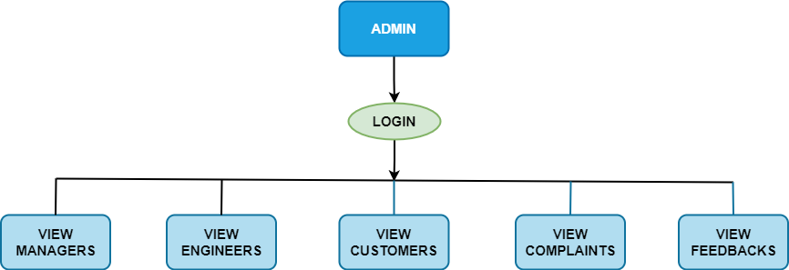
ADMIN FLOW

Slide 15
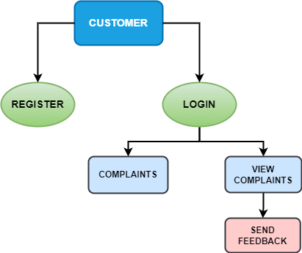
USER FLOW

Slide 16
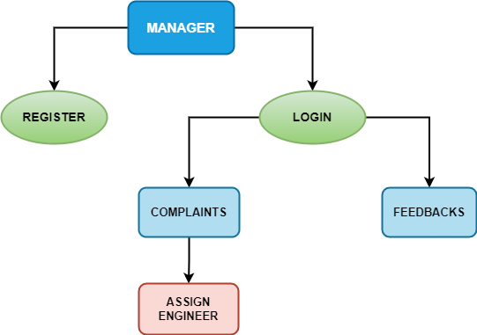
MANAGER FLOW

Slide 17
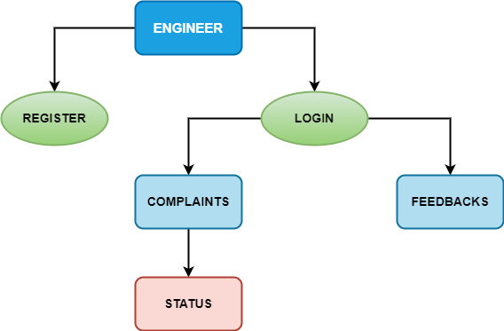
ENGINEER FLOW

Slide 18
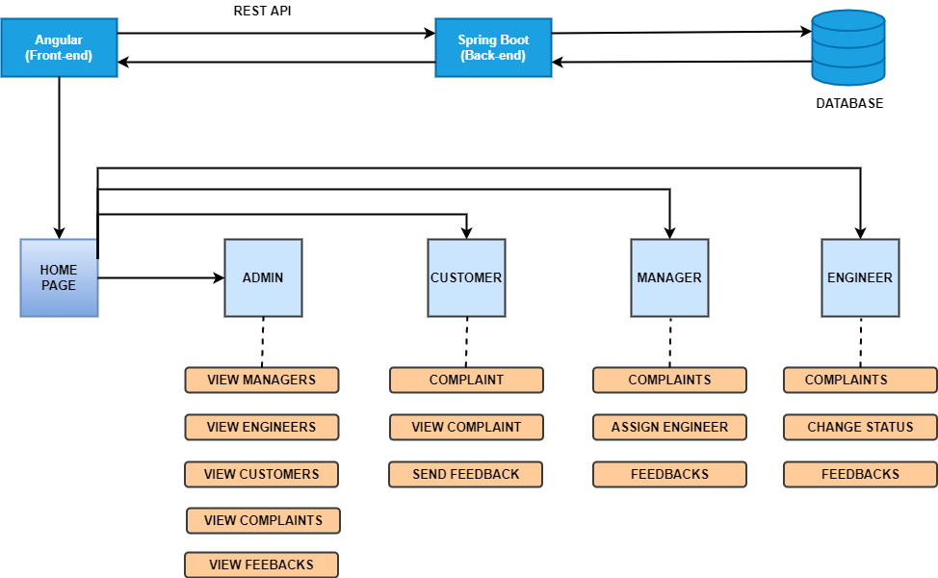
APPLICATION FLOW

Slide 19
ER-DIAGRAM
pincode
engr_ID
mgr_ID
mobile_no
pincode
mgr_name
Assigned to
Cust_name
ENGINEER
admin_name
MANAGER
mgr_ID
engr_name
mobile_no
CUSTOMER
Raised by
mobile_no
Carried by
ticket_ID
ADMIN
address
status
engr_ID
mobile_no
email
cust_ID
ticket_ID
complaint
TICKET
admin_ID

Slide 20
ADVANTAGES &FUTURE IMPROVEMENTS
Fast responses and tracking of complaints are useful for the customers to know their status. This reduces the waiting time of the customers to reach customer care.
The complaints will be redirected or assigned to the respective engineers by matching the customer’s and engineer’s pin code which is easy and flexible to use.
In future we can improve this application by adding more benefits to customers in order to solve the issues faced by them.

Slide 21
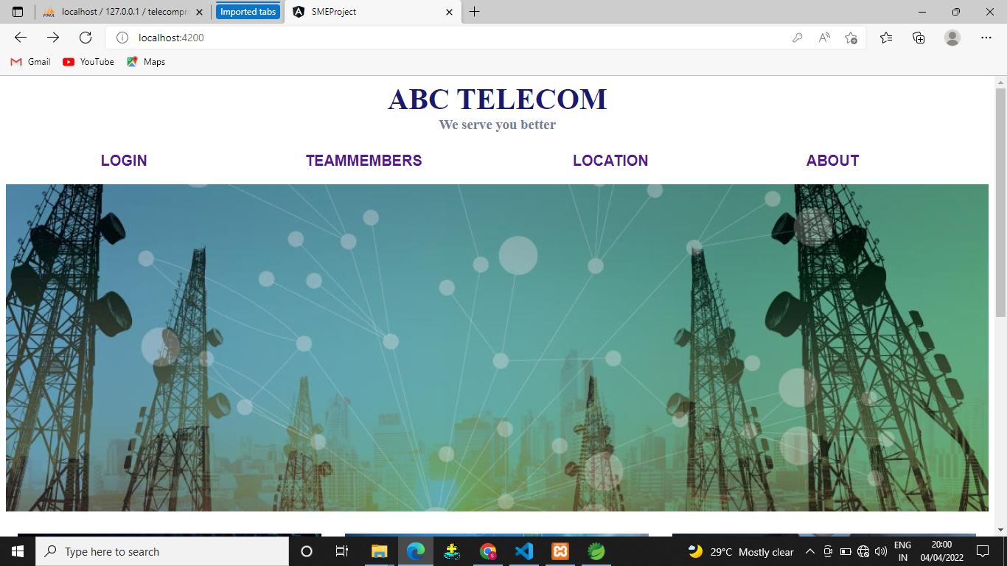
SCREENSDHOTS

Slide 22
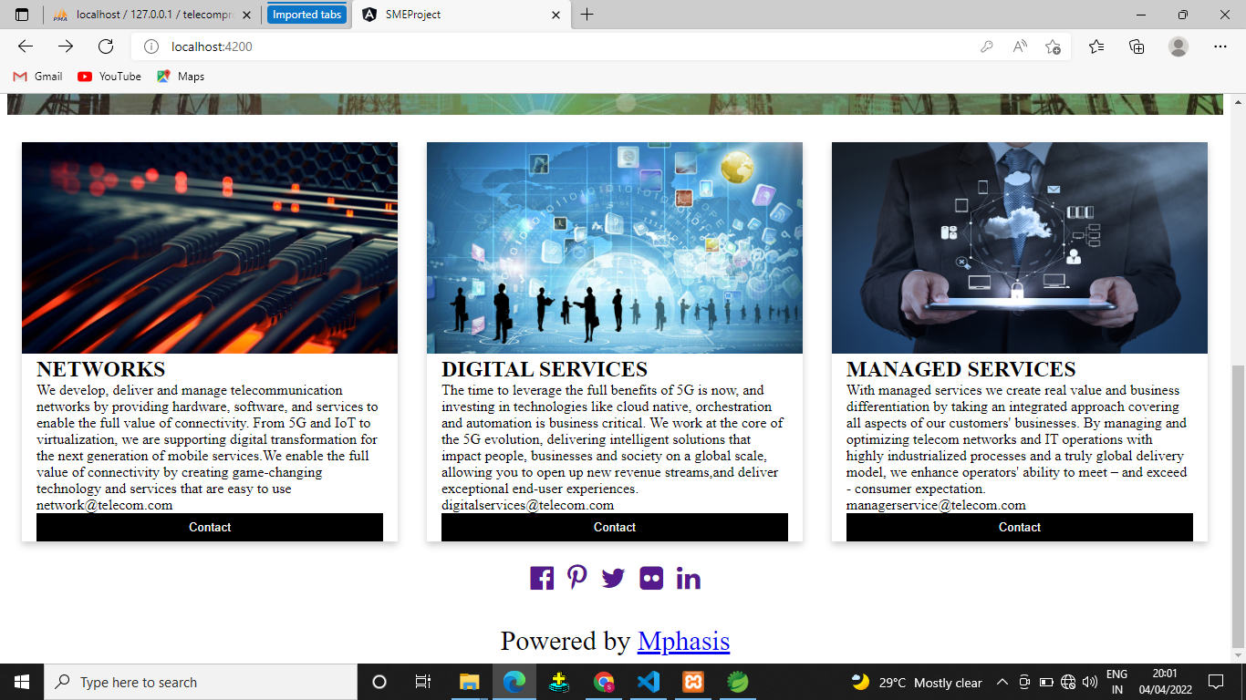

Slide 23
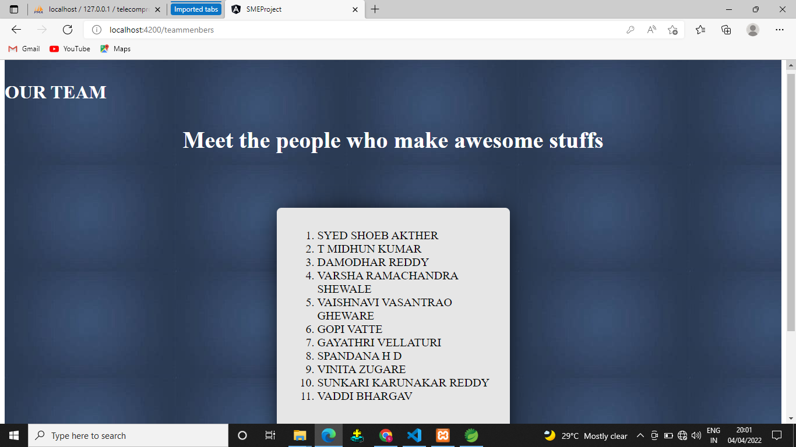

Slide 24
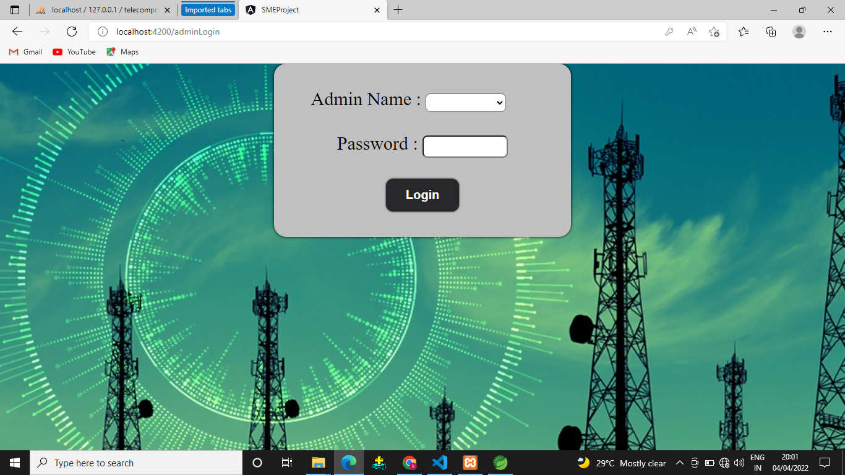

Slide 25
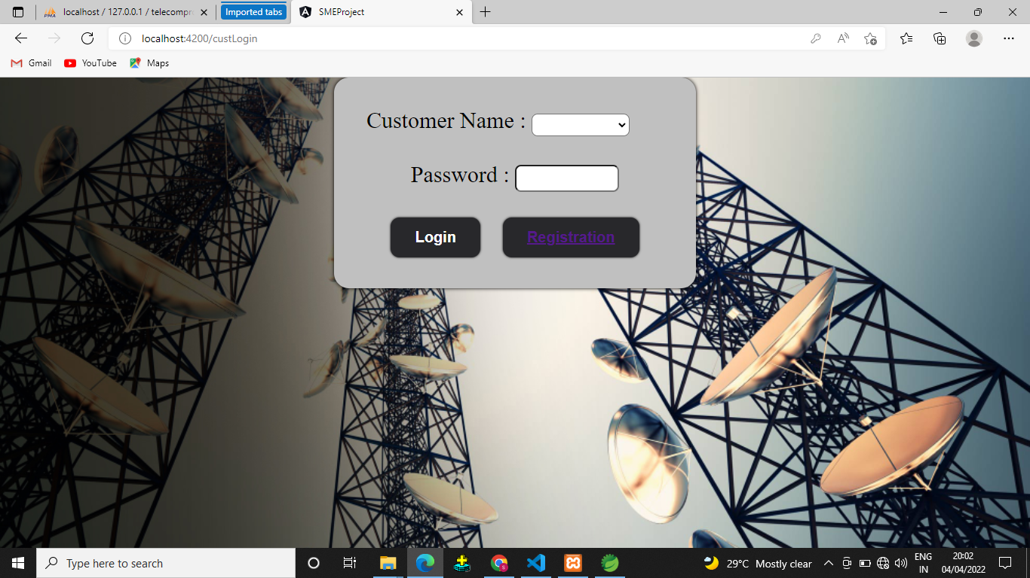

Slide 26
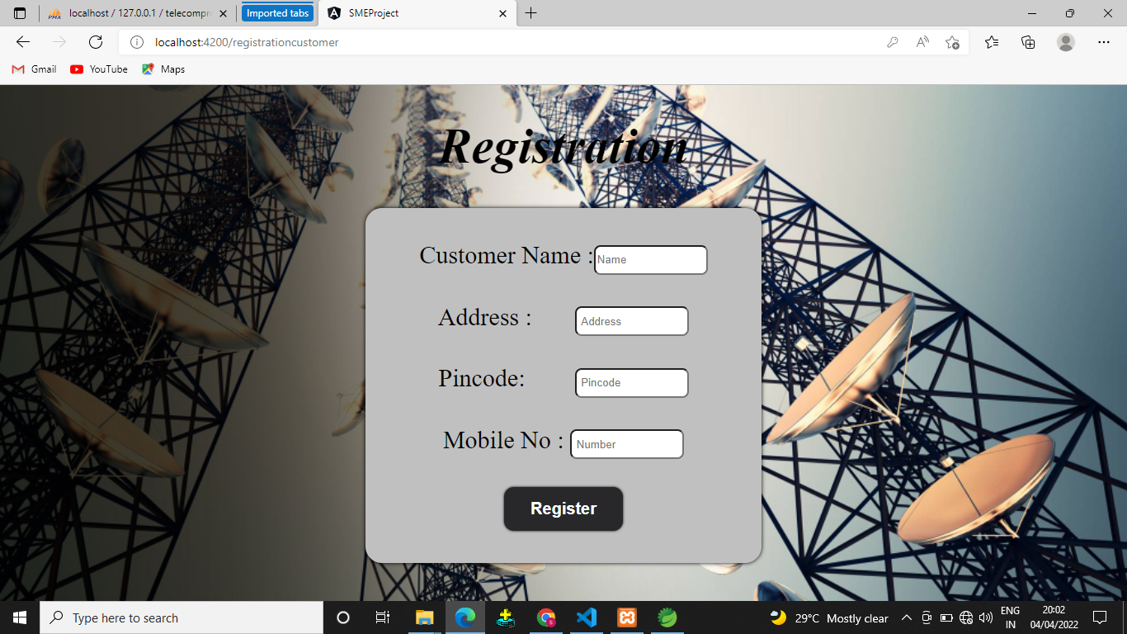

Slide 27


Slide 28
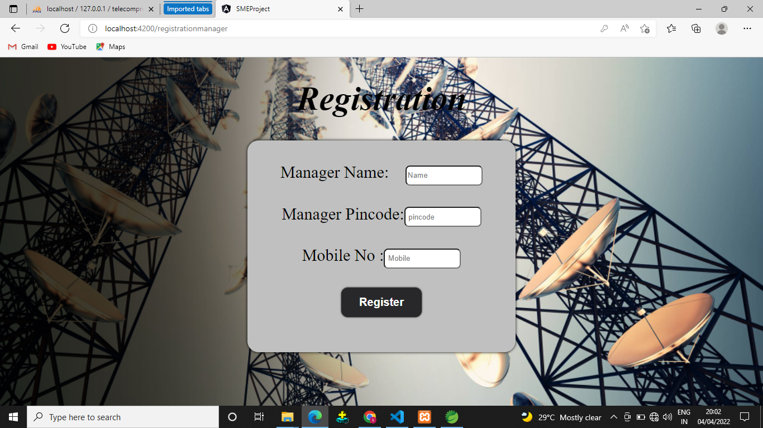

Slide 29
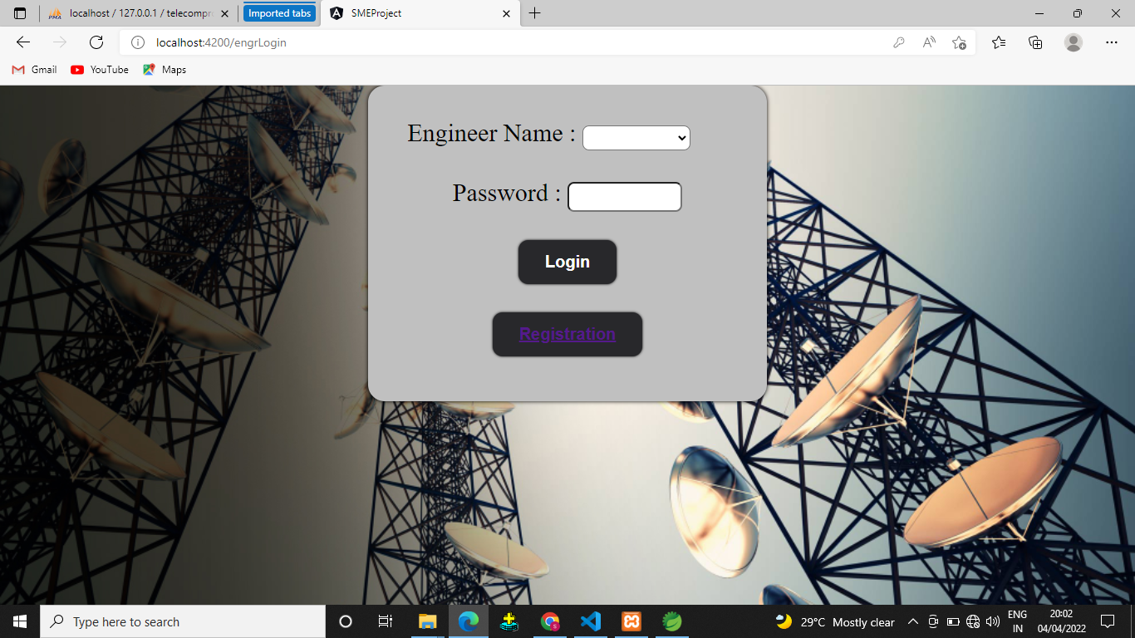

Slide 30


Slide 31
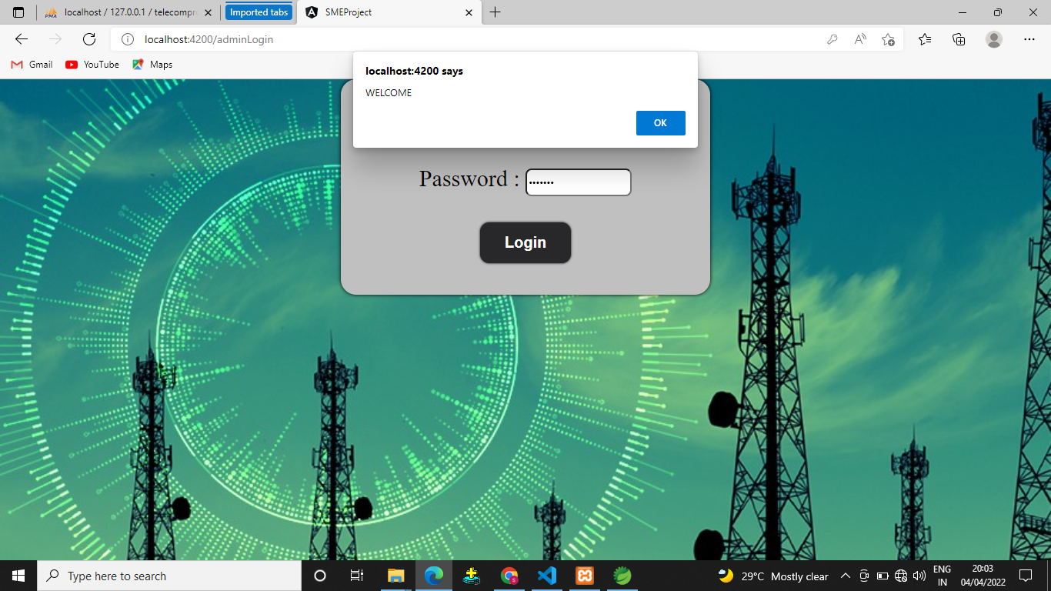

Slide 32
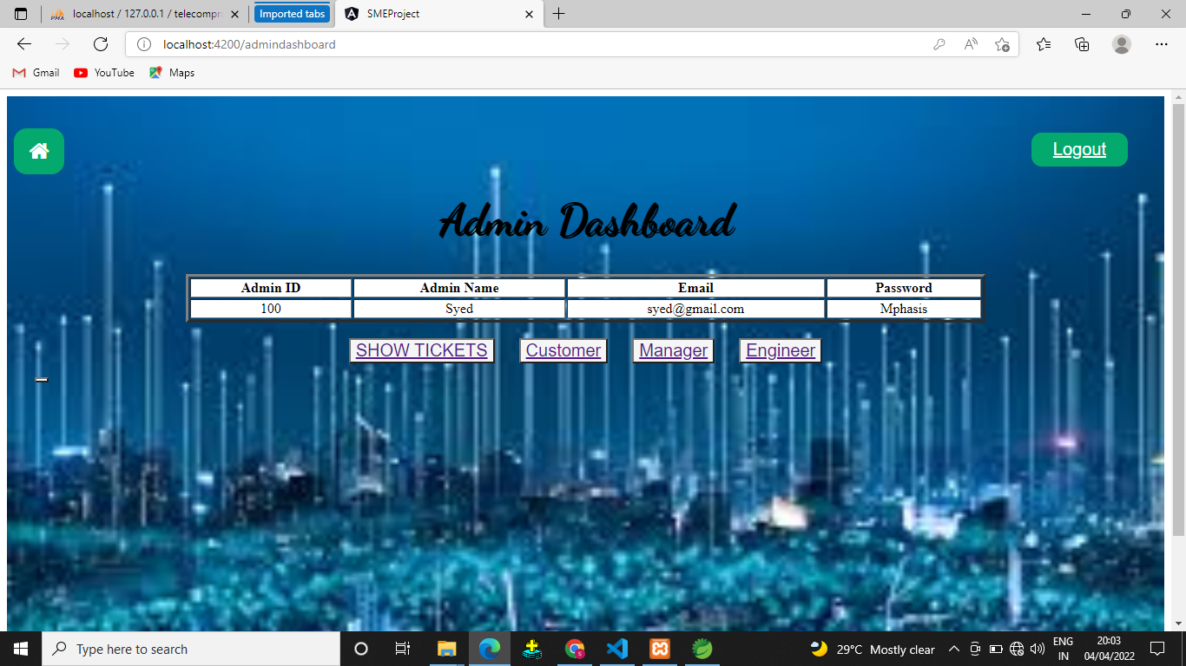

Slide 33
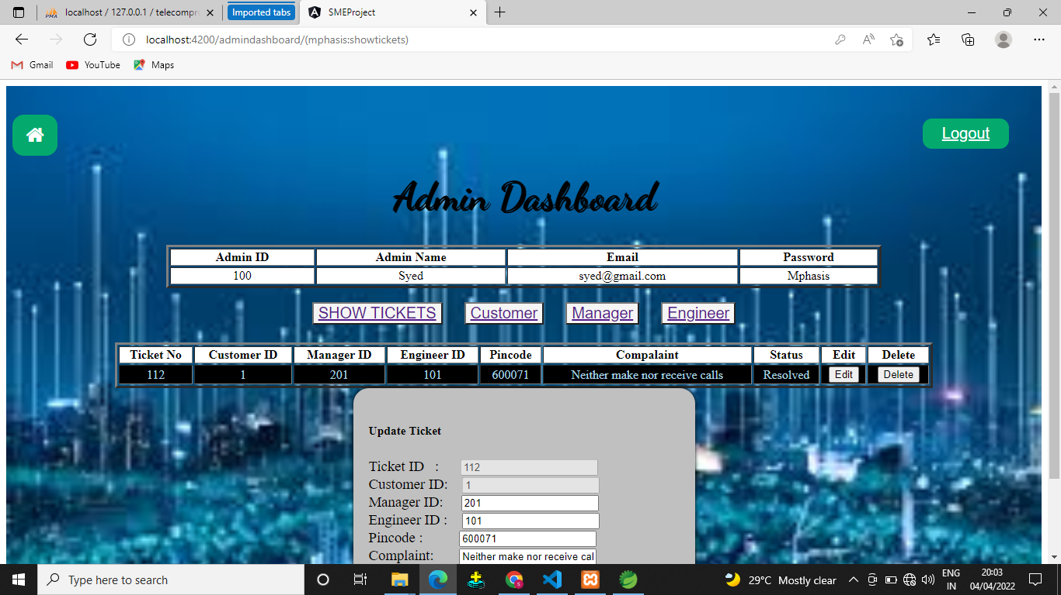

Slide 34
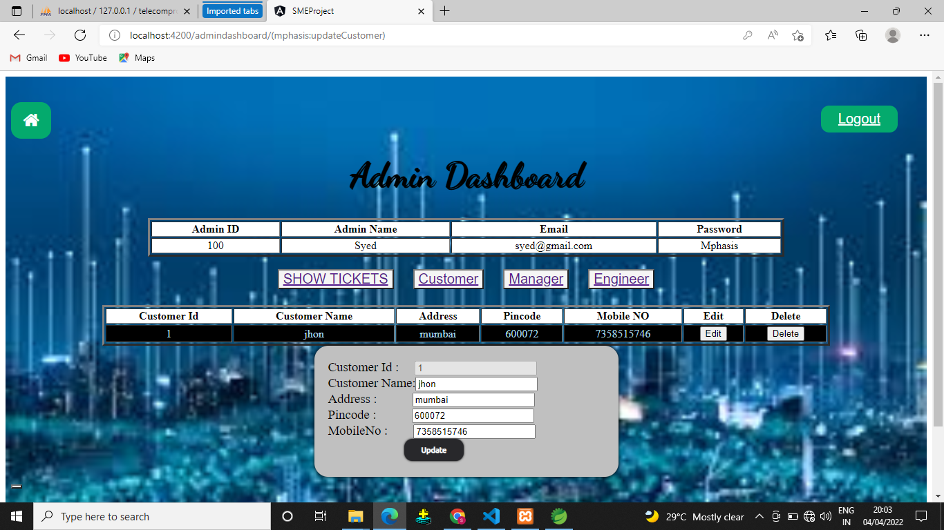

Slide 35
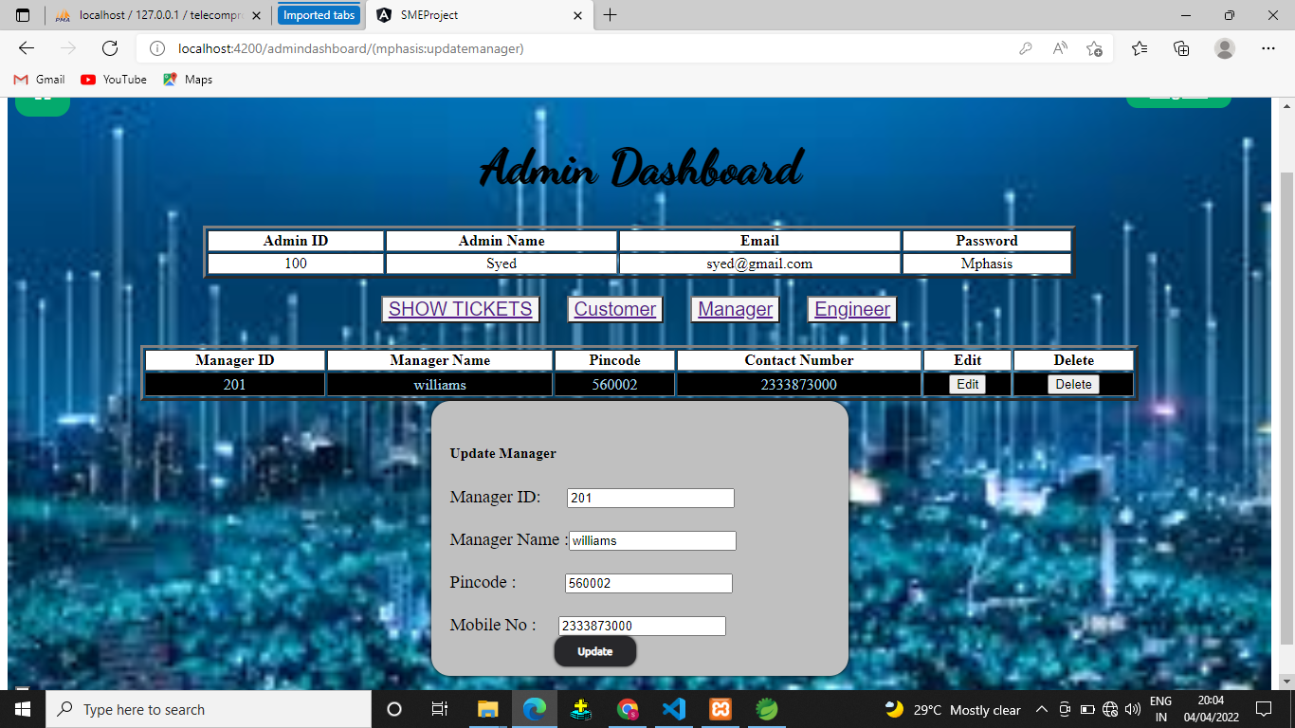

Slide 36
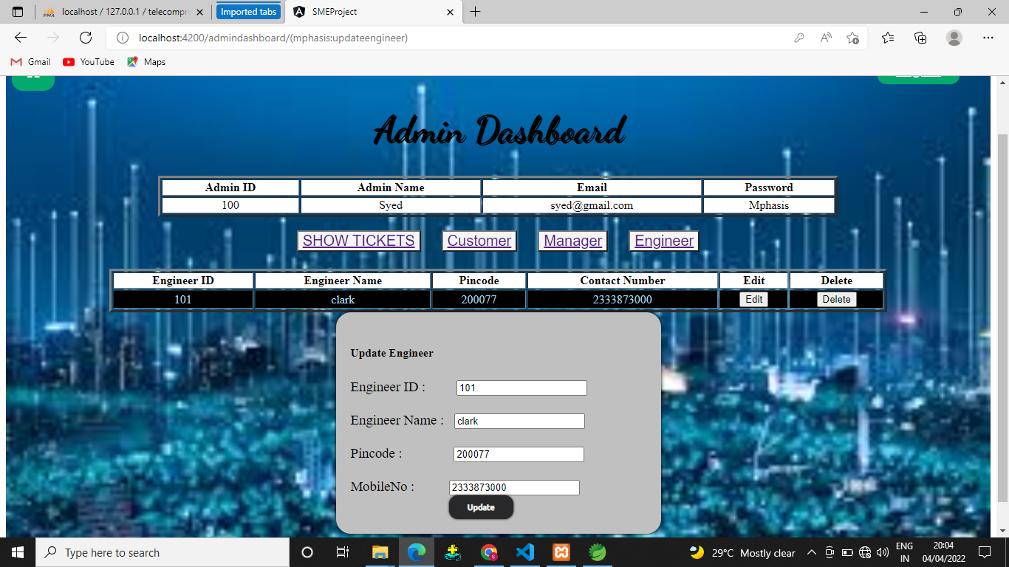

Slide 37
THANK YOU

